Slide 1
Mini Project 1
Smart Calculator
Aditya Chauhan
Roll No. - 2115000055
Computer Science Engineering and Applications.
Nov 30th 2023

Slide 2
Introduction
This project can perform various other calculations rather than simple calculations like BMI(Body Mass Index),Carbon Emission Calculator, Word Calculations and checker.
To make the webpage that helps in making various calculation in one place.
With a help of a click you can switch between various calculators.

Slide 3
Objectives
Perform various other calculations rather than simple calculations like BMI(Body Mass Index),Carbon Emission Calculator, Word Calculations and checker in One Place.
Minimizing the efforts to go to various websites to perform various differnet calculations .

Slide 4
Problem Statement
The Problem to search for various webpages for performing various differnet calculation that consume most of the time of user rather than the user can access a single webpage that provides various calculations facilities in one place.
To help the user to utilize their time rather than surfing site to site .

Slide 5
Literature Review
Different websites that offers online calculators like Arithmatic Calculator ,BMI(Body Mass Index) Calculator , Carbon Emission Calculator , Word Checker and Calculator.
The Project can fill the gap by providing various calculation utilities in a single webpage .

Slide 6
Methodology
The approach is to design a webpage that provides various capabilities of calculations .
Algorithms used are Calculations Formulae applied according to the needs , Techniques such as mathematical expression solving , Tools used such as Replit(online compiler with real time Webview), Languages used such as Java Script, CSS and HTML.

Slide 7
System Architecture
The Project consists of a main webage with its various other constituents webpages that can be accessible by the user according to the needs.
Various components Such as .js(Java Script) files , .css files and HTML files of various Webpages are connected with the help of hyper links within the main webpage of the project.

Slide 8
Implementation
The basic Structure of the webpage is made with the help of HTML , designing is done using CSS and Functionality is coded using Java Scripts.

Slide 9
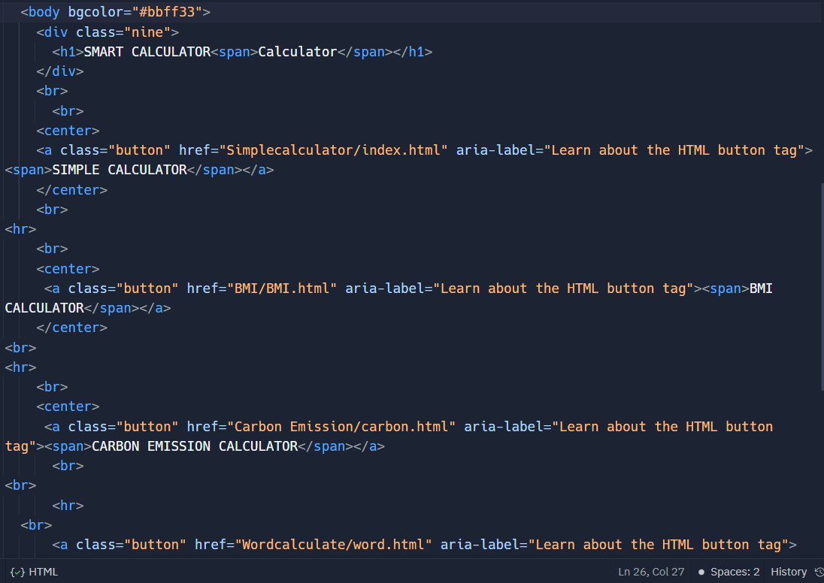
Intro Page (HTML) -

Slide 10
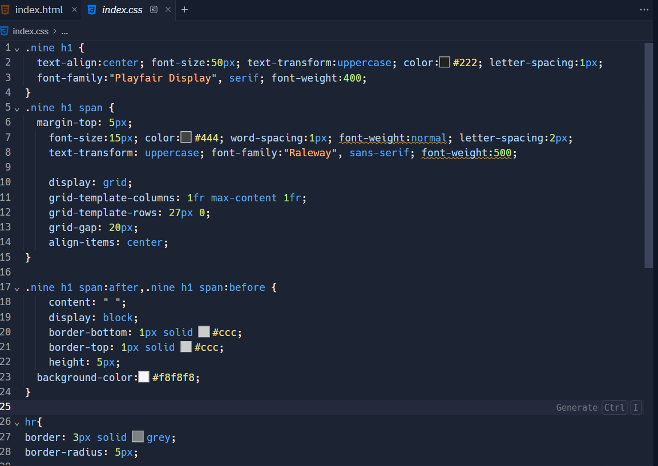
Intro Page(CSS) -

Slide 11
Features
Easy To Use .
Graphical Interface.
Internal Links are Given for easy navigation.
Short and Precise information rather than in brief.
Less Time for Calculating results.

Slide 12
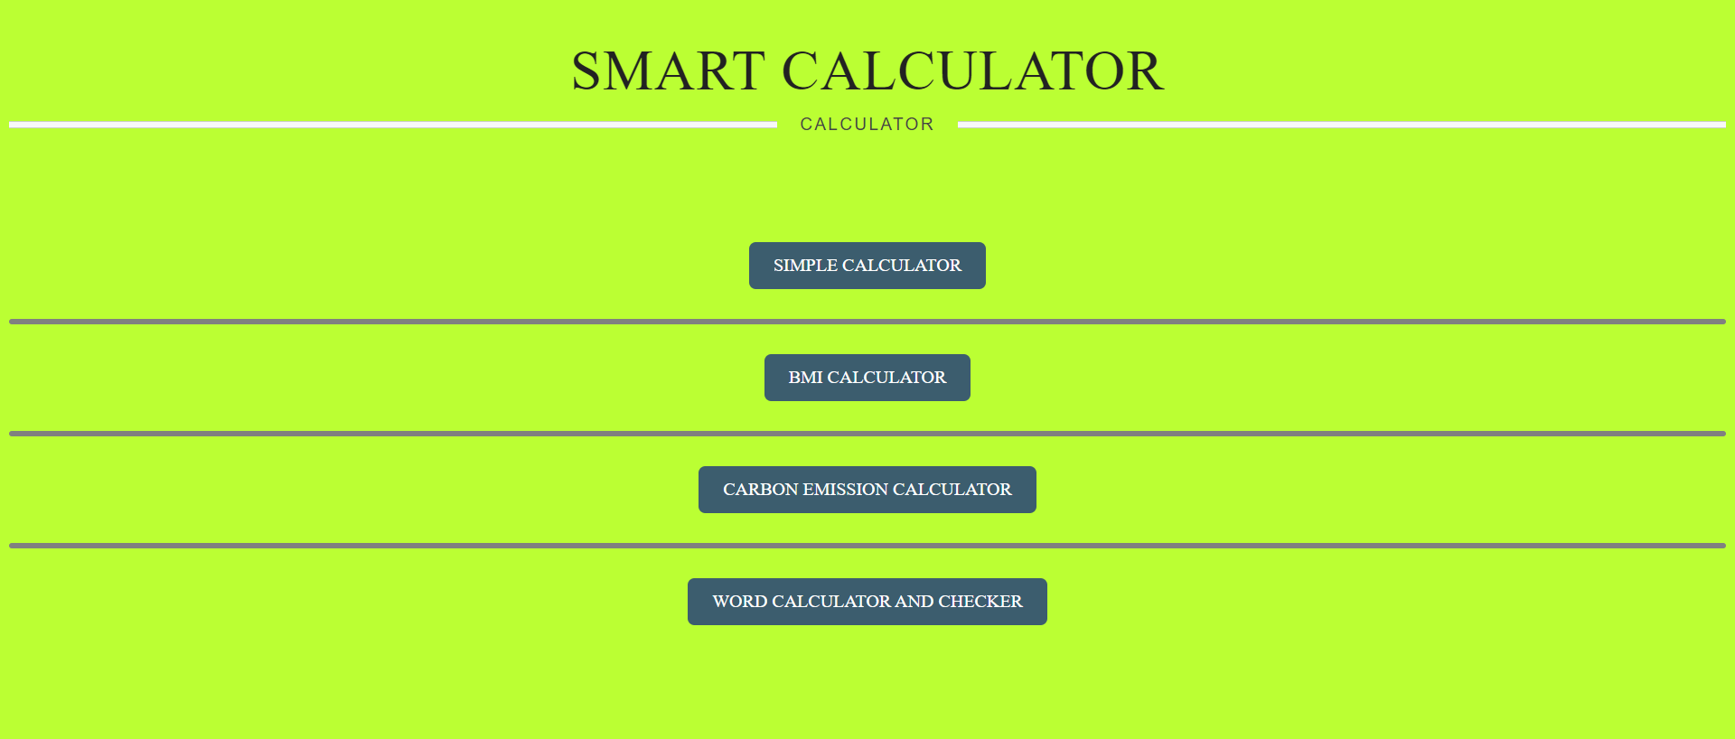
Results

Slide 13
Challenges Faced
Linking of internal webpages through hyperlinking and establishing connection between CSS and Java script file with HTML files for Smooth User Interface Experience.
Learning and Revising Concept again and again and then implementing in the code for removing of bugs.

Slide 14
Future Work
By Providing Various other calculating functions such as trigonometric functions, Scientific Calculations and various other calculations .
Additional Features such as introducing speech to text program for visually impaired people to use.

Slide 15
Conclusion
Algorithms Used are for performing Calculations using Java Scripts.
Webpage made using HTML, Java Script , CSS.
Webpage to perform various calculations in one place.
To reduce the wastage of time by the user for searching for such different websites.

Slide 16
Acknowledgments
I would like to thank Mr. Ankit Arora for helping me identifying and correcting my mistakes in this project.

Slide 17
Q&A
Any Questions from The Audience Side .

